Slide 1


Slide 2
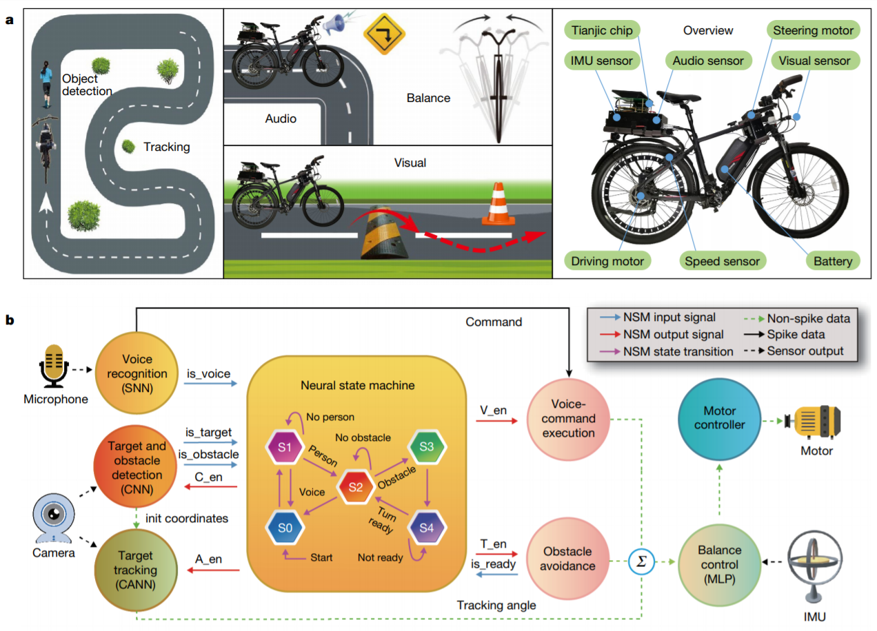
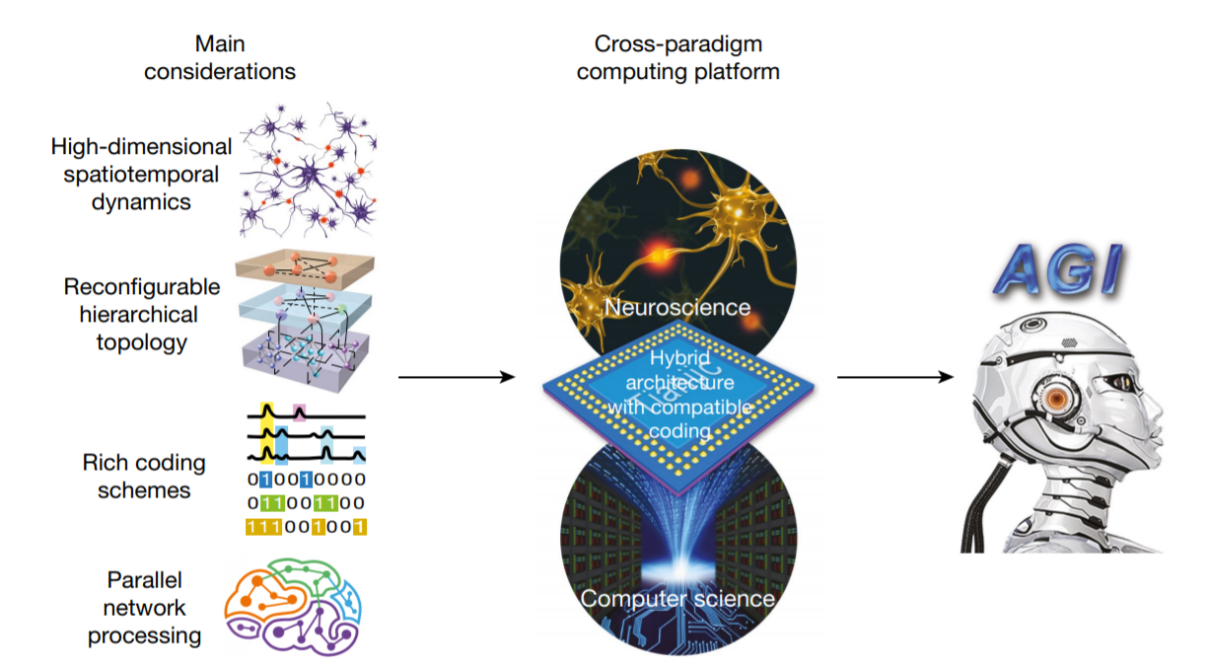
Towards artificial general intelligence with hybrid Tianjic chip architecture

